Slide 1


Advanced ROP Framework: Pushing ROP to Its Limits
ROUGH DRAFT
Dr. Bramwell Brizendine | Assistant Professor | UAH
Shiva Shashank Kusuma | Graduate Student | UAH

Slide 2


Dr. Bramwell Brizendine
Dr. Bramwell Brizendine was the founding Director of the VERONA Lab
  Vulnerability and Exploitation Research for Offensive and Novel Attacks Lab
Creator of ShellWasp:
  https://github.com/Bw3ll/ShellWasp
Creator of the JOP ROCKET:
  http://www.joprocket.com
Creator of SHAREM:
  https://github.com/Bw3ll/sharem
Assistant Professor of Computer Science at University of Alabama in Huntsville
Interests: software exploitation, reverse engineering, code-reuse attacks, malware analysis, and offensive security
Education:
  2019 Ph.D in Cyber Operations
  2016: M.S. in Applied Computer Science
  2014: M.S. in Information Assurance
Contact:
  bramwell.brizendine@gmail.com
  bramwell.brizendine@uah.edu

Slide 3
Bringing a Fresh Perspective to ROP
ROP has been around for so long, with many great tools to facilitate finding ROP gadgets:
  Mona, ROPgadget Tool, Ropper, etc.
  Can we actually contribute something new that has not been done before?
There is another tool for automatic chain generation for Jump-Oriented Programming: the JOP ROCKET.
ROP ROCKET is a culmination of lessons learned in creating JOP ROCKET, SHAREM Shellcode Analysis Framework, and ShellWasp.

Slide 4
The Future is Here: ROP 2.0
Bringing lessons learned from exploring and documenting the functionality of Jump-Oriented Programming, I want to bring some fresh, new contributions to ROP.
Let’s make ROP fresh and exciting again.
  The tried-and-true ways work, but what non-standard approaches can we bring?
Code-reuse-attacks are inherently flexible – let’s stretch the limits of what we can do with ROP in a Windows environment.
Can we take these new ideas and automate them into a vibrant, fresh new tool, ROP ROCKET?

Slide 5

Thinking Outside the Box with JOP
JOP in x86 is fundamentally a very different code-reuse attack from ROP, with its own sets of rules in terms of how it works.
  Prior to JOP ROCKET, there was no tool to provide full functionality for JOP gadget creation.
  Prior to JOP ROCKET, much of the basic mechanics of how to actually do JOP beyond a very simplistic level had never been documented.
JOP is inherently extremely flexible, much more so than ROP.
  Can we bring that flexibility and willingness to do something new to ROP?

Slide 6

Novel Contributions
Next-generation, state-of-the-art ROP gadget tool, ROP ROCKET
Adapting Heaven’s Gate via ROP
Automatic ROP chain construction for important Windows syscalls to bypass DEP
Avoiding the need to bypass DEP – “shellcodeless” ROP
  Automatic ROP chain generation of this
Obfuscation of ROP gadgets
Emulation of ROP gadgets via ROP ROCKET

Slide 7

Heaven’s Gate in ROP

Slide 8
Heaven’s Gate
Heaven’s Gate has been around for about 15 years.
We can invoke this with a long jump or long call.
  These generally won’t work with shellcode or ROP.
More convenient in shellcode is a far return, or retf.
We provide the selector for the CS register: 0x33 → 64-bit
Then we provide the destination address followed by a retf.
  We can get the destination address by a GetPC instruction and adjust the result, pointing it to whatever we want.
Following Heaven’s Gate, we can immediately use x64 code!
  We can transition to 64-bit mode with Heaven’s Gate .
Push 0x33
Call NextRetf
NextRetf:
add [esp],5
retf

Slide 9

New Form of Heaven’s Gate via ROP
With Heaven’s Gate via ROP, our goal is to transition from 32-bit to 64-bit mode.
This has never been attempted via ROP.
Advantage? It can greatly expand the attack surface.
  What may not be feasible in x86 may be possible in x64!
Disadvantage? A lot of setup.

Slide 10
Heaven’s Gate via ROP
This novel ROP form of Heaven’s Gate can allow us to go back and forth from x86 and x64.
  The only consideration is the size of your payload.
While using x86 instructions in x64 ROP is mundane, the opposite certainly is not—and likely has never been done before.
  Expanding from x86 to x64 can provide myriad opportunities, for an expanded attack surface.
This approach from ROP ROCKET is designed for WoW64, 32-bit code; the switch to x64 is just temporary.
  We are not trying to execute x64 WinAPI’s using x64calling convention.
    Technically, from a WoW64, 32-bit executable, you could only call x64 NTDLL functions, likely with limited success. This is not a good idea!
  We are only temporarily expanding the available attack surface.
  We need to transition back to x86 with another usage of Heaven’s Gate.

Slide 11
Expanding the Attack Surface
What is more reasonable is if there is a particularly problematic area, we can load a needed value into an x64 register, and then transfer it to an x86 register.
  Realistically, this is something we would do only if necessary.
Performing Heaven’s Gate via ROP is rather complex and different from the standard approach.
  Fortunately ROP ROCKET can automate the process for us, creating the needed gadgets.

Slide 12

Windows Syscalls:
Background

Slide 13

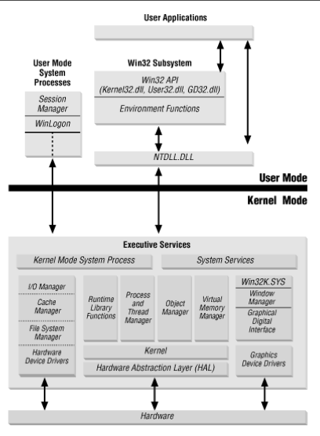
What is a Windows Syscall?
A Windows syscall is made by some functions in the NTDLL library as a way to request a service from the kernel.
The Windows syscall is the last step from user-mode to kernel-mode.
In Windows, syscalls are not intended to ever be used by programmers.
Windows syscalls utilize a special system service number (SSN), which is placed in the eax register.
  SSNs are also known as syscall number or syscall ID.
We believe this is the first usage of direct Windows syscalls in ROP.
  Others have found NTDLL functions with the same name as corresponding syscalls.
    This is very different.

Slide 14
The Appeal of Windows Syscalls
Windows syscalls has become a highly trendy red-team topic for people who create custom software.
  It has NOT been used for ROP or JOP, however.
Malicious WinAPIs can be hooked by EDR, preventing their usage.
This is much less possible with Windows syscalls.
  Thus, functionality implemented by Windows syscalls is inherently more reliable.
  Windows syscalls can be an outstanding way to evade EDR.

Slide 15
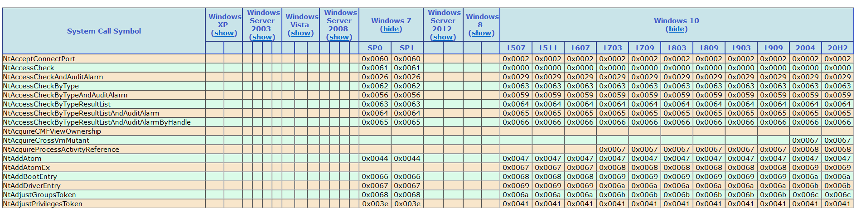
Syscalls: A Problem of Portability
As seen below from Mateusz "j00ru" Jurczyk’s System Call Table, there is a significant problem of portability with syscalls.
Syscall System Service Numbers (SSNs) can change with each release / OS build.
  Many important syscalls remain the same across many releases, changing infrequently.
  Others change more often.
    This makes them inherently unreliable across different OS builds!
    If you were to hardcode a SSN, it could work in one moment, and then a month later the needed SSN has changed

Slide 16
Reverse Engineering
Windows Syscalls

Slide 17

Windows 7: WoW64
In Windows 7 Wow64, the syscall can be found via fs:c0.
  The FS register points to the TIB.
Eax holds the SSN (syscall service number).
  This one points to NtAllocateVirtualMemory
0:009> u ntdll!ntallocatevirtualmemory
ntdll!NtAllocateVirtualMemory:
777ffac0 b815000000 mov eax,15h
777ffac5 33c9 xor ecx,ecx
777ffac7 8d542404 lea edx,[esp+4]
777ffacb 64ff15c0000000 call dword ptr fs:[0C0h]
777ffad2 83c404 add esp,4
777ffad5 c21800 ret 18h
15h = SSN for NtAllocateVirtualMemory

Slide 18
Windows 7: WoW64
We can dereference the TIB + 0xc0 to find a pointer to our far jump.
  We then jump to 64-bit mode.
  The 0x33 segment selector denotes 64-bit mode; 0x23 = 32bit mode
What is at fs:c0?
  It points us to X86SwitchTo64BitMode in wow64cpu.dll.
    By default, this is hidden from the PEB.
    It is a 64-bit library, in 32-bit address space.
    The far jump goes to CpupReturnFromSimulatedCode in wow64cpu.dll.
0:009> dd fs:c0
0053:000000c0 73962320 00000409 00000000 00000000
This far jump lets us transition from 32-bit to 64-bit code.
0:009> u 73962320
73962320 ea1e2796733300 jmp 0033:7396271E
73962327 0000 add byte ptr [eax],al

Slide 19

Windows 10: WoW64
There is a hardcoded offset in NTDLL that leads to the system call.
  Ntdll!Wow64SystemServiceCall leads to ntdll!Wow64Transition.
0:000> u ntdll!ntallocatevirtualmemory
ntdll!NtAllocateVirtualMemory:
76fe2b10 b818000000 mov eax,18h
76fe2b15 ba1088ff76 mov edx,offset ntdll!Wow64SystemServiceCall (77358870)
76fe2b1a ffd2 call edx
76fe2b1c c21800 ret 18h
76fe2b1f 90 nop
18h = SSN for NtAllocateVirtualMemory
0:000> u 77358870
ntdll!Wow64SystemServiceCall:
77358870 ff2528923f77 jmp dword ptr [ntdll!Wow64Transition (773f9228)]

Slide 20
Ignoring Wow64SystemServiceCall?
The new way with Wow64SystemServiceCall and Wow64Transition:
The Windows 7 way with fs:0xc0 still works - backwards compatibility!
76fe2b15 ba1088ff76 mov edx,offset ntdll!Wow64SystemServiceCall (77358870)
0:000> u 77358870
ntdll!Wow64SystemServiceCall:
77358870 ff2528923f77 jmp dword ptr [ntdll!Wow64Transition (773f9228)]
0:000> dd 773f9228
76f67000 76f67000 77099000 00000000 00000000
0:000> dd fs:c0
0053:000000c0 76f67000 00000409 00000000 00000000
Wow64Transition and fs:0xc0 lead to far jump to 64-bit mode!
  Both of these point to 76f67000.

Slide 21
Windows 11?
0:000> u ntdll!ntallocatevirtualmemory
ntdll!NtAllocateVirtualMemory:
77884d50 b818000000 mov eax,18h
77884d55 ba408f8a77 mov edx,offset ntdll!RtlInterlockedCompareExchange64+0x180 (778a8f40)
77884d5a ffd2 call edx
77884d5c c21800 ret 18h
77884d5f 90 nop
18h = SSN for NtAllocateVirtualMemory
0:000> u 778a8f40
ntdll!Wow64SystemServiceCall:
778a8f40 ff2520c29377 jmp dword ptr [ntdll!Wow64Transition (7793c220)]
778a8f46 cc int 3
0:000> dd 7793c220
7793c220 77806000 7793c000 00000000 00000000
0:000> u 77806000
77806000 ea096080773300 jmp 0033:77806009
The old Windows 7 method of invoking syscalls still works!
0:000> dd fs:c0
0053:000000c0 77806000 00000409 00000000 00000000

Slide 22
Much Ado about Windows Syscalls via ROP
Much of Windows-based ROP is focused around bypasses DEP via WinAPIs, e.g. VirtualProtect, VirtualAlloc, etc.
An entirely different approach is with Windows syscalls.
With Windows syscalls, we do not need a pointer to a vulnerable WinAPI, which may or may not be available, and which could be detected via EDR.
While Syscall SSNs do change regularly from one Windows OS build, to the next, for Windows 10/11, we can simply use the same ones across all OS builds for NtAllocateVirtualMemory and NtProtectVirtualMemory.
  With Windows 7, we can use different SSNs and a slightly more complex setup.

Slide 23
Windows Syscalls Via ROP
Whilst we do not require any special pointers, as we do with WinAPI gadgets, we do require a special gadget in order to use Windows Syscalls.
We must somehow have a gadget that leaks the FS register, which points to the TEB.
  Many possibilities exist:
    push dword fs:[edx]
    mov eax, dword fs:[edi]
    add eax, dword fs:[edi]
    xor eax, dword fs:[esi]
    sub eax, dword fs:[edx]
    jmp dword ptr fs:[edp]
    Etc.
Some are easier to work with, but all and similar are possible.
From here, we simply load offset 0xc0 into the register.
Some of these gadgets may not be intended, but may still exist.

Slide 24

There Is No Direct Way to FS Register?
That’s actually okay – we can still get it – we just will perform Heaven’s Gate.
  There is ALWAYS a way to get access to the TEB, which is what is pointed to by the FS register.
  That will leak the x64 R12 register.
  That points to TEB64 – we can dereference the TEB from the TEB64 via R12.
  From there we simply need add 0xc0 to the start of the x86 TEB.

Slide 25
Performing a Windows Syscall in Win 10/11
Whether WinAPI or Windows syscall, if one follows the proper calling convention – with the correct parameters and return address(es), then when you execute the WinAPI or syscall it will work. Simple!
  With ROP, we are just mirroring what is done naturally by the OS.
The approach here is to use a series of mov dereferences to create all the needed parameters on the stack.
  Windows syscalls will require two return addresses.
    One return address? FAIL!
  We can then invoke the syscall with something like a push exx / ret or a push dword ptr fs:[edx] / ret.

Slide 26
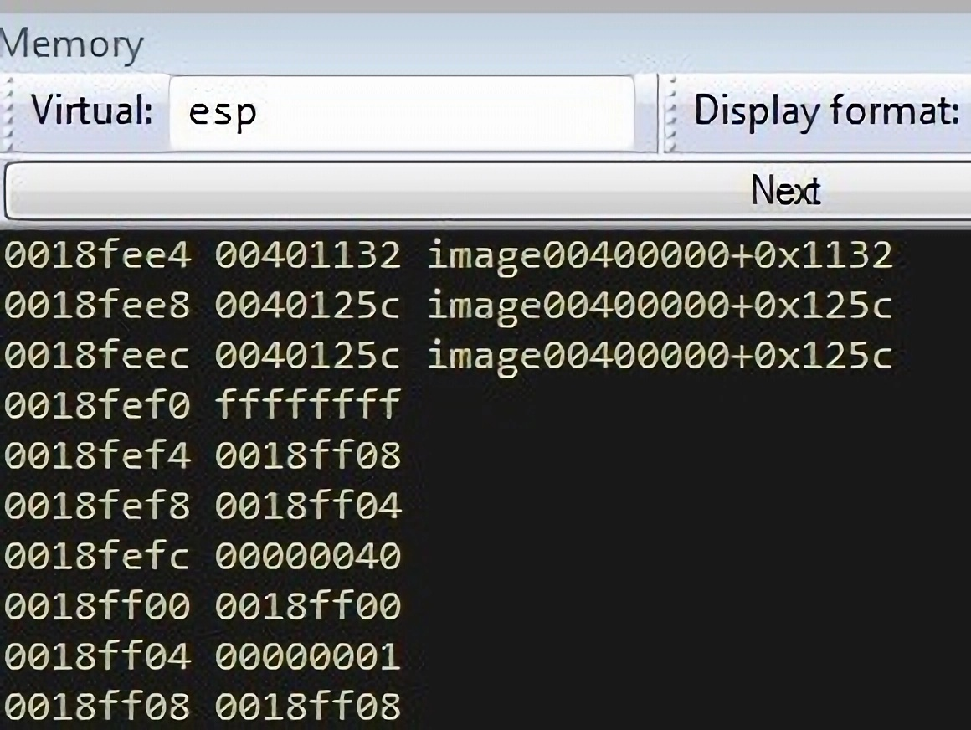
Windows Syscall: NtProtectVirtualMemory
After a stack pivot, we execute the NtProtectVirtualMemory syscall.
Ptr to gadget to invoke syscall
Return Address #1
Return Address #2
NtProtectVirtualMemory paramaters

Slide 27
Windows Syscall: NtProtectVirtualMemory
The push dword ptr fs:[ebx], with ebx having the offset of 0xc0, allows us to push the location of the start of the Windows syscall onto the stack.
The ret then ensures we immediately go to that the far jump that initiates the WoW64 Windows syscall. sequence.

Slide 28
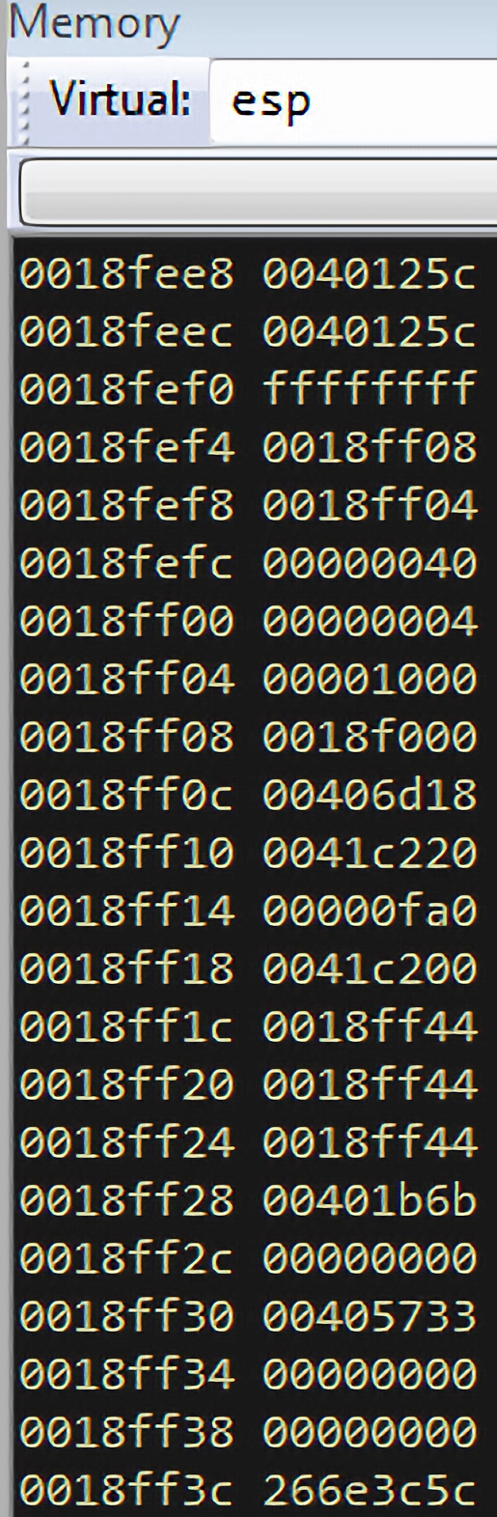
After the NtProtectVirtualMemory Syscall
After the Windows syscall, the pointers will update with new values.
NtProtectVirtualMemory “rounds down” to the base address of the allocation, from 0x0018f008, to 0x0018f000.
The size changes from 1 to 0x1000.
  This is the maximum size for this particular range of memory.
Return Address #1
Return Address #2
NtProtectVirtualMemory paramaters
Size
Base Address

Slide 29
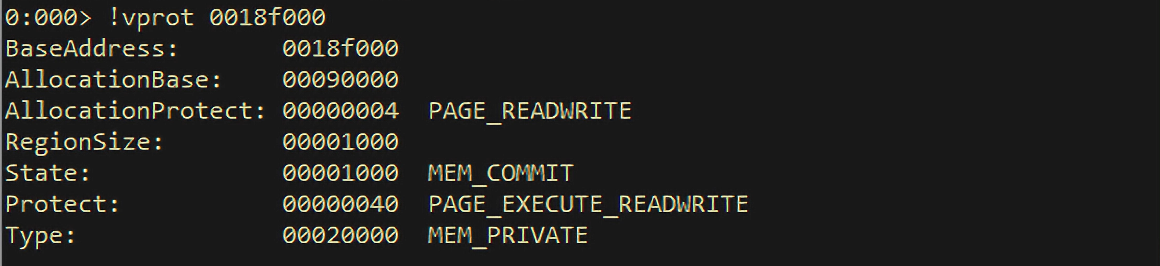
After the NtProtectVirtualMemory Syscall
We can observe clearly that we were able to change memory to RWX, allowing for shellcode written there to be made executable.

Slide 30

Tricks to Setting Up NtProtectVirualMemory
Unlike with WinAPIs, with NtProtectVirtualMemory, we must use pointers to needed values.
In fact, we require three pointers:
  BaseAddress
  NumberOfBytesToProtect
  OldAccessProection
Rather than going to efforts to put very precise values, we can “cheat” a little.
  With BaseAddress, we can get any address pointed to in that same memory range.
  With NumberOfBytesToProtect, we can simply put 1 or any arbitrary value that does not exceed the size of the Allocation.
  By using imprecise values, it will round down the BaseAddress, and the NumberOfBytesToProtect will round up the size of the allocation.

Slide 31
Windows Syscalls in Win7
There is an additional requirement that ecx must be zeroed out.
Edx also must have the address of the first parameter.

Slide 32
Avoiding the Need to Bypass DEP:
“Shellcodeless” ROP

Slide 33
“Shellcodeless” ROP: Avoding the Need to Bypass DEP
Bypassing DEP is often a central point, but we needn’t always bypass DEP.
  Sometimes we may prefer to simply ignore DEP.
Why do we bypass DEP? Simply so that we can execute shellcode.
What if we reimplement the shellcode through pure ROP, or “shellcodeless” ROP?
  Then there is no need to bypass DEP and we have similar or equivalent functionality to executing shellcode.
We call the desired WinAPIs directly with the appropriate parameters, each loaded via ROP.
  These different WinAPIs, much like ROP gadgets, can be chained together to produce complex functionality, equivalent to a shellcode.

Slide 34
“Shellcodeless” ROP
This technique has been around in ROP for a while, but very rarely done, due to elaborate setup.
  Brizendine and Babcock also provided a “Shellcodeless” JOP attack for a previous Black Hat, allowing for an executable to be downloaded and then executed.
Two approaches can be done with “shellcodeless” ROP – firstly via pushad and alternatively via mov dereferences, where you precisely build the parameters onto the stack.

Slide 35
“Shellcodeless” ROP
ROP ROCKET endeavors to automate this attack via pushad.
With pushad, we preload registers with certain values, such that after pushad, they are aligned on the stack in precisely the correct order, for that API to be called.
  This is how we do VirtualProtect or VirtualAlloc with older tools like Mona.

Slide 36
Patterns for WinAPIs
As part of this research, we have sought to establish patterns for loading registers, to enable these to be called via pushad.
  That is, once you execute pushad, the WinAPI is automatically called with the appropriate parameters, and then returns to desired location.
We have created numerous patterns for APIs such as GetProcAddress, LoadLibrary,System, UrldownloadtoFileA, and CreateProcessA.
Having multiple patterns means that if it is not possible to succeed with one pattern, due to insufficient gadgets, we can simply try another pattern.
Some WinAPIs have several alternate patterns.

Slide 37
Shellcodeless ROP Attacks
We have created sets of patterns for different “shellcodeless” attacks:
LoadLibrary->GetProcAddress->System
  This attack can allow us to execute an arbitrary command.
LoadLibrary->GetProcAddress->UrlDownloadToFileA->CreateProcessA
  This attack can allow us to download an execute a binary, which could be disguised as a JPG or similar.

Slide 38
Obfuscation of ROP Gadgets

Slide 39
Obfuscation of ROP Gadgets
As mentioned, ROP ROCKET is very powerful in its ability to encode and decode any ROP gadget, regardless of bad bytes, allowing it to be used.
  This is done by pre-encoded the gadget address, and then using one of several techniques to “decode” it, allowing it to then be executed via push exx /ret.
  This can be done with common pop gadgets and very large numbers; that is to say, the raw ingredients for this are plentiful.
An entire ROP chain could be fully obfuscated by utilizing the above, with the true gadgets only being apparent at runtime.
  We might, for instance, see a large number of pop, add, and push gadgets.
  You would need to follow along in a debugger to understand what the ROP chain was trying to do.

Slide 40
Highly Effective Way to Obscure ROP Gadgets
ROP ROCKET has special custom functionality to allow it to try, if necessary, hundreds or thousands of possibilities, until one is found that works with the bad bytes.
In a majority of cases, this will be quick for the tool to attempt.
  The only exception would be if there was a large number of bytes unavailable – but it seems improbable that we would encounter a binary where the number of bad bytes would be so large as to make this problematic.
Obfuscation of an entire ROP chain can greatly increase its size, so there must be sufficient space available.
  This approach may not always be possible.

Slide 41
ROP ROCKET: Next-Generation, State-of-the-Art ROP Tool

Slide 42
ROP ROCKET: Features and Capabilities
Only a handful of tools have attempted automatic ROP chain generation successfully. This is a rare capability.
  JOP ROCKET is the only one for JOP.
Blazing fast at finding ROP gadgets—utilizes parallelism, to maximize available cores, when finding gadgets.
  It is orders of magnitude faster than some.
  A few seconds to 30 seconds (for extremely large binaries) may be required to find all ROP gadgets.
Persistence – save the initial gadgets found for a binary, if you wish to return to them again later without needing to rescan it.
  ROP ROCKET finds everything all at once, and you can go back and search through things or generate chains.
Static analysis tool – can work independently of a debugger.

Slide 43
ROP ROCKET: Features and Capabilities
Powerful automatic ROP chain generation for several types of attacks, including Windows syscalls, traditional WinAPIs (VirtualProtect), and Heaven’s Gate.
  ROP ROCKET has new chains and patterns for chains never attempted before.
Provides an alternate way to call popular WinAPI attacks, such as with VirtualProtect, using mov dereference, sniper attacks.
Provides a config file for customization of options.
Pleasant UI via command line.

Slide 44
ROP ROCKET
Python tool.
ROP ROCKET finds both 32-bit and 64-bit gadgets for 32-bit binaries.
  Since ROP ROCKET automates Heaven’s Gate, we can transition between them
Saves gadgets into numerous categories based on operation and register, such as pop eax, push edi, so that finding a desired gadget is very easy.
Highly efficient, optimized algorithm for gadget finding—all gadgets are found, both intended and unintended.
  This optimization is inspired by what JOP ROCKET does.
Outputs to screen and to text file.

Slide 45
Why Does ROP Chain Generation Fail?
ROP Chain generation comes down to a determinate recipe or formula.
It fails because the needed gadgets for a particular purposes (e.g. load EAX with some value) cannot be found.
That doesn’t mean ROP is not possible – a manual approach can be more successful.
It just means that the automated approach is insufficiently flexible.
One reason gadget chain generation may fail is due to bad bytes, so overcoming bad bytes – being able to use gadgets in spite of bad bytes – would solve this problem.

Slide 46
Bad bytes? No Problem
ROP ROCKET is extremely powerful in that it can load any registers virtually, without regard to bad bytes.
ROP ROCKET has optimized techniques to overcome bad bytes:
  Integer overflow
  Neg
  XOR
  Not

Slide 47
Using and Loving Gadgets with Bad Bytes
With ROP ROCKET, no gadgets are out of bounds, due to bad bytes.
The framework provides several methods to overcome bad bytes.
We can still use gadgets with bad bytes, such as 0x00401234.
  The 0x00 being inherently problematic as a null byte.
We simply “encode” it and use a technique of integer overflow, not, neg, or XOR to “decode” it.
  Once this is done, then a Push exx / ret, allows the newly decoded gadget address to be pushed onto the stack.
  The ret then causes it to be immediately executed.
ROP ROCKET fully automates this old technique, allowing it to unlock and use virtually any “forbidden” ROP gadget.
  ROP ROCKET has a very high success rate, with novel techniques to use these whilst considering bad bytes.

Slide 48
Overcoming Bad Bytes
This approach has been used via automation for bad bytes with respect to values loaded into registers, but not as a means to use the problematic gadgets themselves.
I have taught this technique for years, but it has never been a part of a tool.
This is a foolproof method can virtually always work.
The algorithm to find the needed integer overflow is extremely sophisticated and complex, with many helper functions.
  It will virtually always succeed, but if not, there are other backup methods of “encoding” the bad bytes, so that they can be decoded via push exx / ret.

Slide 49
Integer Overflows for the Win
ROP ROCKET first tries to encoded the problematic ROP gadget address / value with one of a set of prebuilt values, assuming bad bytes are not an issue.
If those do not succeed, it generates new values to use in the integer overflow, using a set of available bytes.
  The question here then is the second value to be used has bad bytes.
  If it does, then the process continues, until it can find a pair of values free of the bad bytes, to produce the desired value, via integer overflow
  Most of the time this process is fairly quick, although it can potentially try thousands if need be.
The general approach of the tool is to try to generate values using normal means, and then it can try alternative means, such as integer overflow.

Slide 50
Emulation of ROP Gadgets via ROP ROCKET

Slide 51
Emulation of ROP Gadgets
ROP ROCKET uses emulation in a couple decidedly different but equally important ways.
First, it can find alternative or equivalent gadgets to something that may be more desirable.
  For instance, rather than mov edi, ebx / ret, which may not be available, we might find mov edi, ebx / xor ecx, 0xde / ret
  ROP ROCKET can evaluate the less desirable gadget to see if it works as an alternative.
    Does it clobber needed registers that need to be protected?
    Do we can that it changes ECX?
With this approach, we can expand the attack surface and reduce the need for manual writing of parts of the ROP chain.

Slide 52
Emulation of ROP Gadgets
If ROP ROCKET is searching for mov edi, ebx / ret, if it cannot find that, it can evaluate less desirable forms.
With ROP chain generation, typically we look for just a single-line ROP gadget, as we cannot predict possible side effects to other registers from other gadgets.
This allows us to find and perhaps use “less desirable” gadgets.
Each ROP gadget candidate is emulated, and it is evaluated to see if the side effects to other registers are acceptable or not.
  What registers are protected? Which are not?
ROP ROCKET is trying to automate additional steps that a human might have to do to make a generated ROP chain work.
ROP ROCKET saves emulation data for each gadget, allowing it to avoid unnecessary emulations.

Slide 53
Thank You!

